Slide 1
Basic Networking
Concepts and Techniques

Slide 2
What is networking?
High level overview:
Making two or more computers talk to each other
Enhancing real life interactions through networked communications
Other bullshit like that
Low(er) level:
Data encapsulation
Transfer of packets within a local area network (LAN)
Routing of packets between different LANs
Service management
Data security

Slide 3
Part I
Data Encapsulation

Slide 4
Data Encapsulation
Data encapsulation is the process of taking data or a packet and then wrapping it in the header and footer of a lower level protocol.

Slide 5
Data Encapsulation - Why?
Well, most devices that handle traffic don't need to know about the data within a packet to deliver to the next step in the chain.
Only the device configured to receive that data will de-encapsulate it (unwrap it) fully.

Slide 6
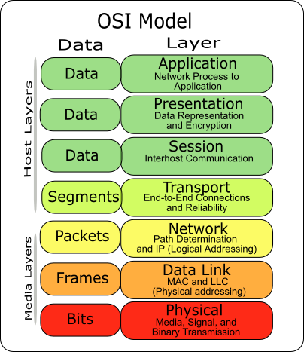
Data Encapsulation - The OSI Model
http://upload.wikimedia.org/wikipedia/commons/d/d3/Osi-model-jb.png
Notes:
Just a model, TCP/IP doesn't actually use the OSI model.
Used fully in some other protocol stacks, most of which totally outmoded and deprecated
The OS generates some data - this is the application layer data.
The OS figures out what type of encoding to use or whether or not to use encryption. That's wrapped in the presentation layer.
The OS creates a socket (UNIX) that starts a session with the other computer. That's the session layer.
Then the data from the above layers gets packed into either a TCP or UDP segment. This contains some adressing information, in the form of ports. Depending on the protocol choice, there might be some other header information.
The OS hands the TCP or UDP segment down the stack to the IP layer. The IP wraps its headers around the TCP/UDP segment, creating the IP packet. The segment from TCP/UDP IS the data for the IP packet. The IP packet contains information for internetwork routing, like addressing and fragmenting.
The packet gets wrapped in the Data Link header AND footer (if there is one). The frame has local network addressing capabilities

Slide 7
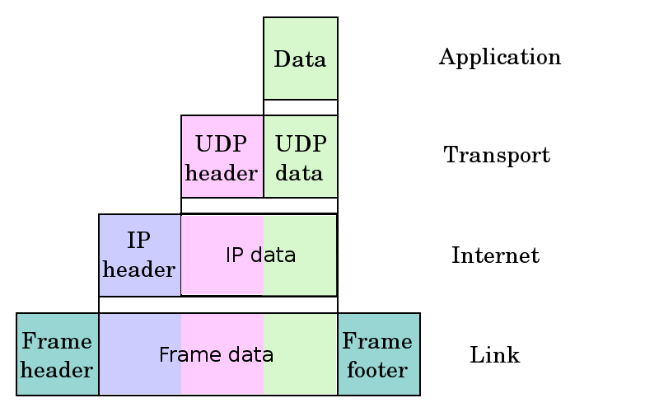
Data Encapsulation - TCP Model
http://en.wikipedia.org/wiki/File:UDP_encapsulation.svg
Notes:
Older than the OSI model, used in TCP/IP (no surprises there).
Can switch in TCP for UDP.
Also, this diagram is nice in that it clearly shows how data from the above layers gets wrapped with the headers of the protocol below it.
The TCP model combines the three topmost layers because they are ridiculously abstract and OS specific. Whatever the OS hands down to the transport layer is considered application data.

Slide 8
Data Encapsulation - Summary
OS generates data
Data gets recursively wrapped with headers down the stack
Sends the data out over the network in a frame
Destination receives the frame
Destination de-encapsulates the frame recursively up the stack
Destination OS processes data

Slide 9
Part II
Basic Network Protocols

Slide 10
Ethernet II
Layer 2 Frame
Uses MAC addresses for sending and receiving data
Holds at most 1500 bytes of data per frame
Layer 3 agnostic
Fuck 802.3
Notes:
Jumbo frames
802.3
Talk about how MAC addresses are responsible for local addressing
Special types of addressing:
Broadcast:
ff:ff:ff:ff:ff:ff
Multicast:

Slide 11
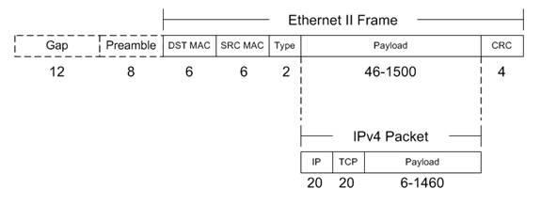
Ethernet II Frame
http://www.tamos.net/~rhay/overhead/ip-packet-overhead.htm
Notes:
Discuss the different fields, review encapsulation, lead into ARP.

Slide 12
ARP
Specialized protocol that requires IP and Ethernet
Glue between IP and Ethernet
Allows hosts to get MACs from IPs
Computer knows IP but doesn't know MAC
Sends out broadcast message to that IP asking for MAC
Waits for a response from the computer with the IP
Adds the hosts's IP and MAC address to an ARP table
Notes:
Go through two examples, 1 local, 1 global:
Local:
IP network, 192.168.1.1 and 192.168.1.2
192.168.1.1 wants to send a packet to .2.
192.168.1.1 sends out an ARP request to the broadcast ethernet address
192.168.1.2 hears broadcast and processes it because the message has its IP, it sends a response
192.168.1.1 adds it to the ARP table and sends a response
(Get to IP Addressing before covering this)
Global:
192.168.1.1 wants to send a pack to 129.21.49.50.93
192.168.1.1 sends out an ARP request to the broadcast MAC and the gateway's IP
Gateway responds with its MAC
Host sends

Slide 13
Internet Protocol
Layer 3 packet
Connectionless
Uses 32 bit IP addresses for addressing
Responsible for internetwork packet routing
Holds at most 65535 bytes per packet
Notes:
Welcome to the TCP/IP Suite! This is the first TCP/IP packet type we've seen so far.
Things of note:
Has no notion of connections. Leaves that to upper level segments (TCP) to work out.

Slide 14
IP Addressing
IPs are 32 bit binary numbers!
Usually written out in dotted quad form: "129.21.50.94"
Also come with subnet mask, also 32 bit binary number!
Usually looks something like this: "255.255.254.0"
Or in binary: 11111111 11111111 11111110 00000000

Slide 15
IP Addressing II
To determine if a machine is on your local network:
AND the address and the subnet mask
AND your address and the subnet mask
If both are equal, it's on the local network
Else, set the MAC address to your default gateway, and have it send the packet
Notes:
To determine if a machine is on your local network:
AND the address and the subnet mask
AND your address and the subnet mask
If both are equal, it's on the local network
Else, set the MAC address to your default gateway, and have it send the packet

Slide 16
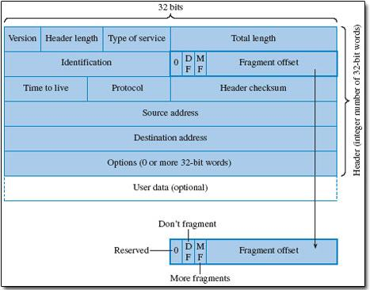
IP Packet
http://openlearn.open.ac.uk/file.php/2587/T823_1_016i.jpg
Notes:
Ignore QoS stuff - not in scope of seminar
Identification - used to identify each packet (useful for fragmentation)
Fragmentation offset - used to sequence fragmented packets
How IP fragmentation works:
Checks MTU - see if it needs to be fragmented
If it does, breaks up the packet into smaller packets, with the same ID number
Fragment offset is set: size of packet so far /8

Slide 17
Transmission Control Protocol
Layer 4
Connection oriented
Process level routing
Port addressing

Slide 18
TCP Adressing - ports
Port number (16 bit integer)
End point for process to receive data
Port doesn't actually exist, it is just a place for a process to listen for (and send) packets

Slide 19
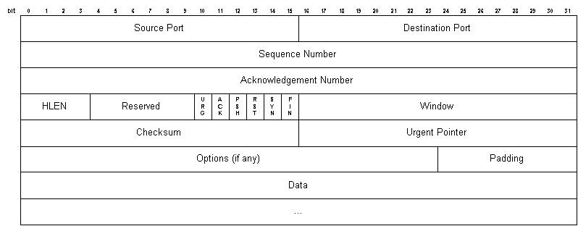
TCP Segment
http://condor.depaul.edu/~jkristof/technotes/tcp-segment-format.jpg
Notes:
Packets are called segments
Sequence number - what number byte the first byte is, offset from initial sequence number from three-way handshake
Acknowledgement number - If ACK, it sends the next sequence number. If it's not an ACK, set to 1
HLEN - Header length in 32 bit words
Flags -
URG - urgent, can interrupt stream of data. only on remote host, NOT QoS. Must be processed right away
ACK - acknowledgement
PSH - push data to upper layer
RST - used to reset connections
SYN - used to start connections
FIN - used to close connections
Window - number of bytes sender is willing to receive without ACK
Checksum -calculated to verify of header and data
Urgent pointer -offset from sequence number of last byte of urgent data
http://en.wikipedia.org/wiki/Transmission_Control_Protocol

Slide 20
3 Way Handshake
Initiation
Client sends packet with SYN flag set
Server responds with SYN and ACK flags set
Client responds with final ACK
Closure
Client sends FIN
Server sends FIN-ACK
Client sends ACK
Notes:
SYN sets the initial sequence number. The client sets its own, as does the server. This is used to compute all subsequent sequence numbers
Closure doesn't always happen like that.

Slide 21
User Datagram Protocol
Layer 4
Connectionless
Process level routing
Port addressing

Slide 22
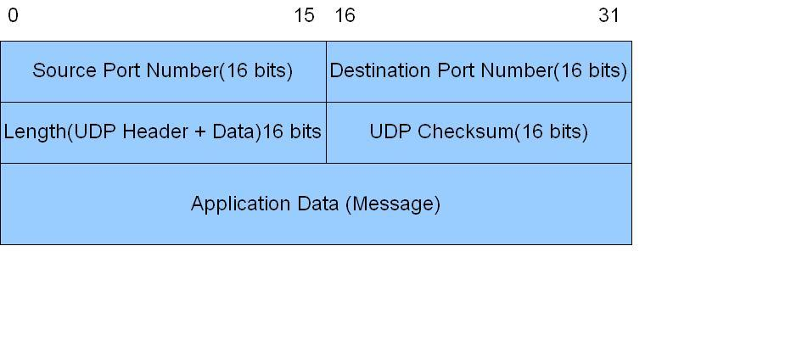
UDP
http://upload.wikimedia.org/wikibooks/en/d/d9/Header_of_UDP.jpg

Slide 23
UDP - Why?
Faster than UDP
Upper level protocols might add own ACK functionality
ACK might not even be necessary for protocol
Notes:
Faster than TCP because
Carries more data in one chunk
Doesn't have overhead of ACKing every packet
No overhead of creating connections

